Slide 1
Key words
Electric current
Current density
Resistance
Resistivity
Ohm’s law
Power
Resistive dissipation
Semiconductors
Superconductors
Capacitive time constant
(RC time constant)
Electromotive force
(emf ε)
Voltmeter
Ammeter
Terminal Voltage
Kirchhoff’s rules
Farad (Faraday)
Ampere (Ampère)

Slide 2
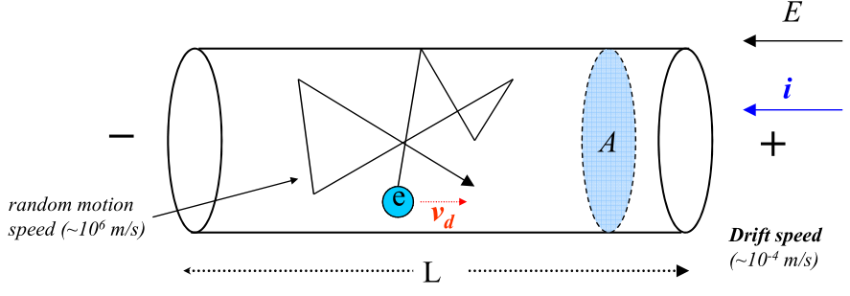



Electric current
(definition of current)
Drift Speed of the Charge Carriers
ampere(A)
1 A=1 C/S
Current density
Notes:
This current is the amount of positive charge arriving at this cross-section A during time interval dt, remember this definition!
In this book, the current density always parallel to the dA, that means J always through A
For the conductor, the current density and drift velocity can be related by this formula, here n is the charge density.

Slide 3
Resistance and resistivity
Definition of Resistance
Relationship between resistance and resistivity
Ohm(Ω)
1 Ω =1 V/A
Definition of resistivity(ρ) and conductivity(σ)
ρ is only related to the material properties
Notes:
This is the definition of R, from this two equations, we can derive this one for the case that A is uniform for all L, and this L is the length along the current.
For the conductor, the resistivity can be describe by those quantities.
Here we say this equation only valid for uniform A along L (or current direction), let’s look an example:

Slide 4
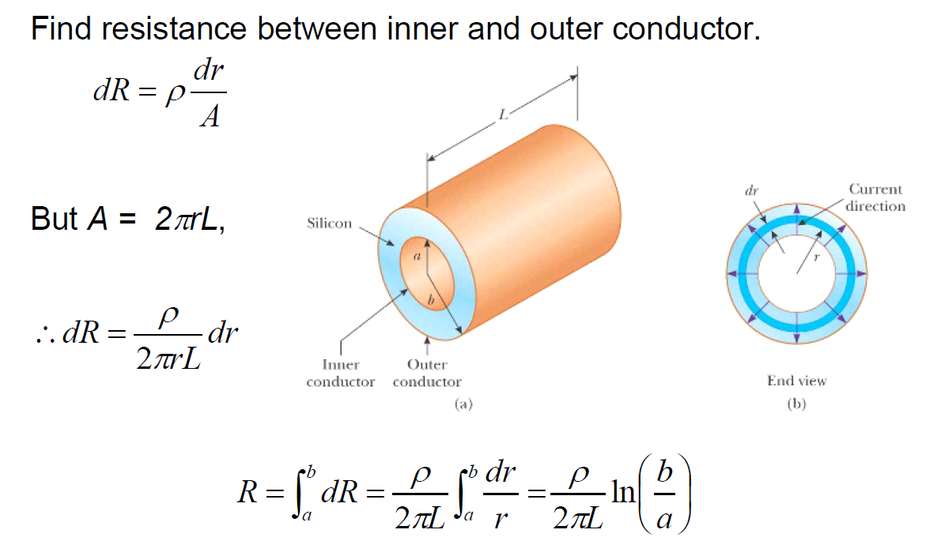
Resistance depends on the way of connection
The resistance of a resistor depends on how it is connected to the circuit :
Current direction
Notes:
This is a cylindrical conductor, for the right one, the current is along this direction, so for each tiny segment dl, A is the same, so we have
For the left side one, the current is along the radial direction, so for each dl, or we call dr, the corresponding area is the side face(flank) area of the cylinder, that is 2pirL, as r increases, the A increase, so we have to calculate resistance for each cylindrical shell, and then sum them up. In other word, we have to use integral to calculate R. for the shell with radius r and width dr, the resistance is:
Then we do the integral from the inner shell to out shell, that is from r=a to r=b, then we get the R, it’s big different from this one although for the same conductor.

Slide 5
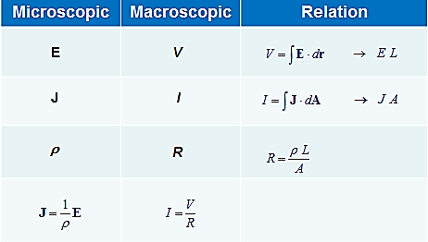


Ohm’s law
Microscopic and macroscopic quantities in ohm’s law
Power:

Slide 6
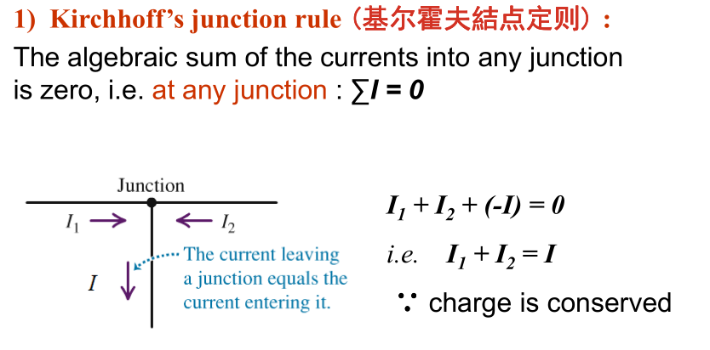
Kirchhoff’s rules
Notes:
Junction rule: for a given junction, the current into it must be equal to the current out of it.

Slide 7
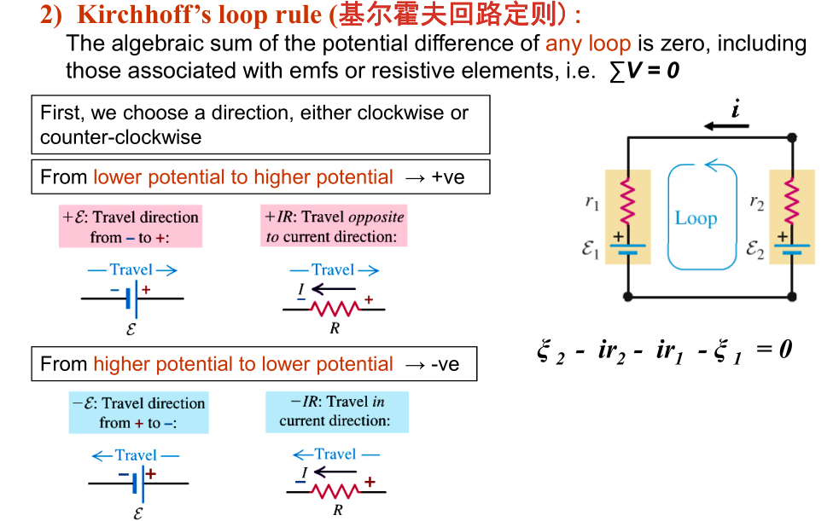
Kirchhoff’s rules
Notes:
Static electric field is a conservative field, the integration does not depend on specific route, so we have loop rule: for a close loop, the total change in potential along the loop must be 0.
Usually, There are three kinds of device in a circuit, for the battery, from lower potential, the negative terminal to higher potential, the positive terminal, the potential increases, so the change in the potential is positive +E， for the resistor, along the direction of current, the potential decreases, so if the loop direction is the same as current’s direction, the change in potential is negative and the value is -ir. The potential change depend on the direction of current for a given loop. So before we use loop rule, first, we should assume the current direction. As the figure shows, then we can use loop rule, we start at this point, along the loop and move through e2,, from negative terminal to positive terminal, the potential change is , and then move through r2, along the current, the potential change is negative , and then move through r1, is still –ir1 and then through e1, from positive terminal to negative terminal, potential change is - , then back to starting point, the total change in potential must be 0. we also can write as this:
Starting from a, the potential is Va, then back to a ,the potential is still va ,so we have:

Slide 8
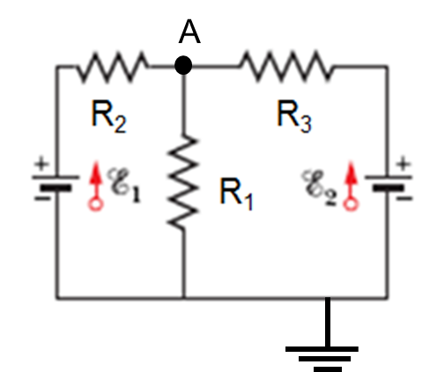
Problem 1
ε₁ =8.00 V , ε₂ =12.0 V, R₁ =100 Ω，R₂ =200 Ω and R₃ =300 Ω， one point of the circuit is grounded (V=0).
What are (a) The size and (b) direction ( up or down)of the current through resistor 1, (c) the size and (d)direction (left or right) of the current through resistor 2, the (e) size and (f) direction of the current through resistor 3? (g) what is the electric potential at point A？
Notes:
First, assume the direction of currents, for example, like this, use junction rule for junction A. into A from left side i2, into A from right side i3, out of A i1, then we have:
i1=i2+i3 (equation 1)
Then use loop rule. In this problem, we have three unknown, so we need three equations, we already have one equation, we need another two, so we need choose two loops:
choose loop 1 like this:
Start from this point, first move through e1,from negative to positive +, and then move through R2, along the direction of current, so potential decrease, -ir1----
Choose loop 2 like this:-----
Then combine these three equations, we can figure out i1,i2 and i3
Start from point A and choose one route to the ground, for example this route:
VA-i3r3=0

Slide 9
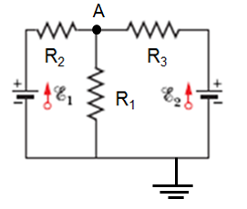
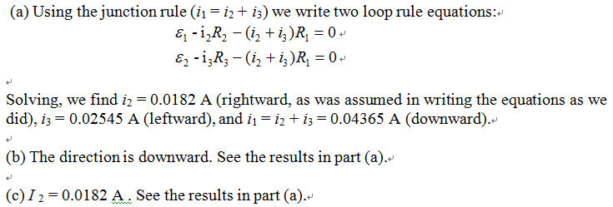
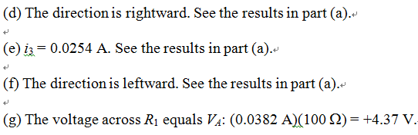
Answer 1
0.0437

Slide 10
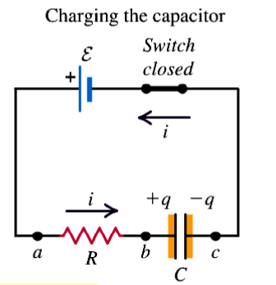
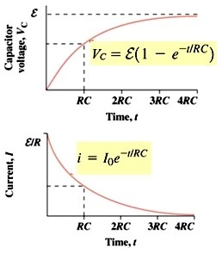






RC circuits
capacitive time constant
τ
Notes:
If here has a battery, then is a charging circuit, first assume the direction of current, and then choose a loop, write the loop equation:
And then solve this differential equation, we can get the q and I as a function of time t.
When the time t=0, that means just after the switch is closed, q must be equal to the initial q, for example 0 for an uncharged capacitor, and the current must get its largest value
When the time goes to infinity, then means the switch has been opened for a long time, the capacitor has been fully charged, so the value of charge can not change, q must be a constant , current must be 0. and q=cV

Slide 11





RC circuit – charging
→
Energy supplied by the power :
The energy stored in the capacitor when it is fully charged:
The energy dissipated by the resistor during this process
The total energy dissipated by ths resistor is independ of its resistance

Slide 12
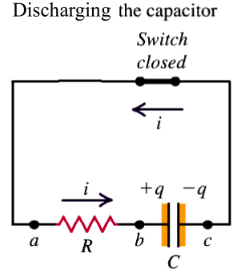
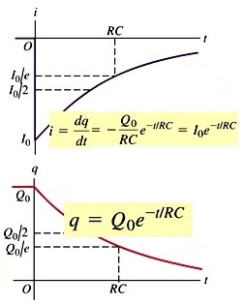






RC circuits
τ
Notes:
Please keep in mind, the I is the current in the circuit, the q is the charge on the capacitor, for discharging process, q must decrease, that means dq/dt must be sampler then 0
So if you choose I along this direction, so i=dq/dt is indeed smaller then 0, but if you choose this as the direction of the current, then I should be a positive value.
At this case, you can guess i=-dq/dt, why, think about it.

Slide 13
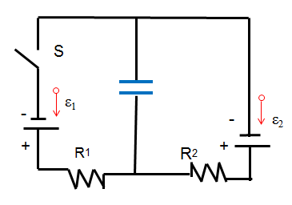
Problem 2
The circuit below shows a capacitor, two ideal batteries, two resistors, and a switch S. initially S has been open for a long time. If it is then closed for a long time , what is the change in the charge on the capacitor? Assume C=10μF , ε₁ =1.0 V , ε₂ =3.0 V, R₁ =0.20 Ω and R₂ =0.40 Ω
C
Notes:
Initially, S have been open for a long time, so only e2 charge the capacitor, and the capacitor can be considered to be fully charged, so
Qi= CV=CE2
Finally ,the switch has been closed for a long time, at this case , the e2 charge or discharge to capacitor, and a new balance has been arrived because a long time, so the charge on C does not change, that means the current through C is 0, so the we can simplify the circuit as, and we want to find the potential difference between the terminal.
Assume the current moves along this way, and then use loop rule to find its value.

Slide 14
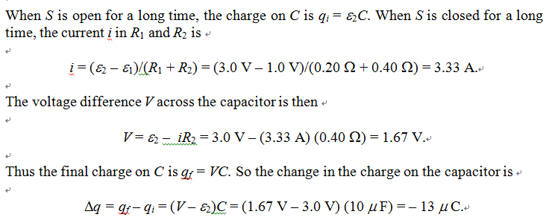
Answer 2

Slide 15
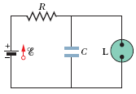
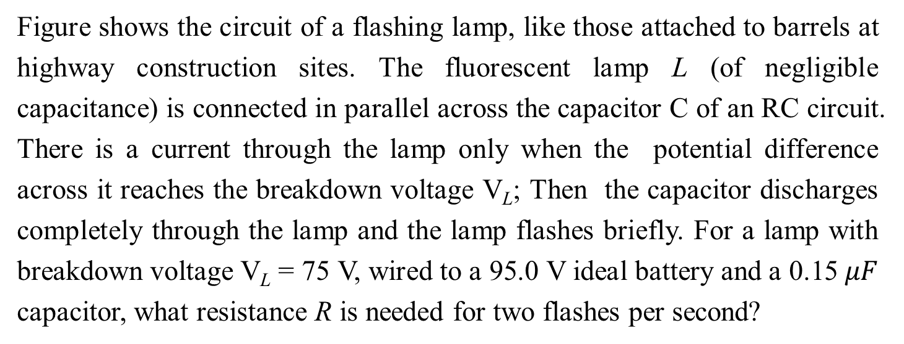
Problem 3
Figure shows the circuit of a flashing lamp, like those attached to barrels at highway construction sites. The fluorescent lamp L (of negligible capacitance) is connected in parallel across the capacitor C of an RC circuit. There is a current through the lamp only when the potential difference across it reaches the breakdown voltage V_{L}; Then the capacitor discharges completely through the lamp and the lamp flashes briefly. For a lamp with breakdown voltage V_{L} = 75 V, wired to a 95.0 V ideal battery and a 0.15 $μF$ capacitor, what resistance R is needed for two flashes per second?
Notes:
Two flashes per second, that means one flash per 0.5s, and usually this time contains two times t1, the time need to charge the capacitor from 0v to 75v, and the time need to discharge capacitor, here can be considered as 0, we can omit this time , only t1 needed to be considered
For this equation, where t=0.5s, Vl=75V e=95V, find R=?

Slide 16
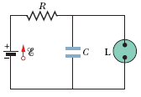
Answer 3
The time it takes for the voltage difference across the capacitor to reach V_{L} is given by:
Where we used t = 0.5s given (implicitly) in the problem.

Slide 17
Problem 4
A 3.00M Ω resistor and a 1.00μF uncharged capacitor are connected in series with an ideal battery of emf ε=4.0V . At 1.00s after the connection is made, what is the rate at which
(a) the charge of the capacitor is increasing ,
(b) energy is being stored in the capacitor,
(c) thermal energy is appearing in the resistor ,
(d) energy is being delivered by the battery?

Slide 18
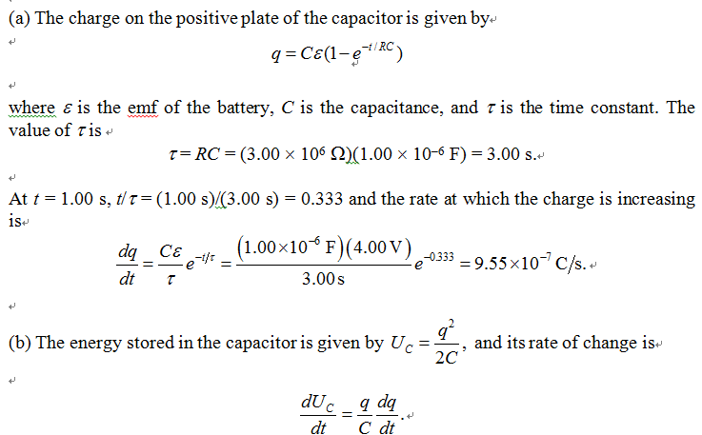
Answer 4

Slide 19
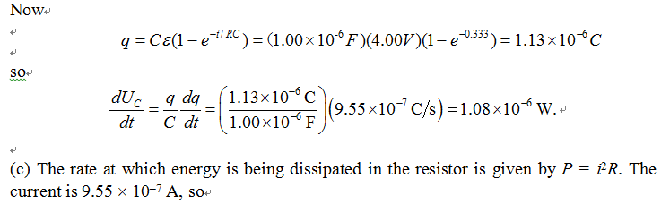
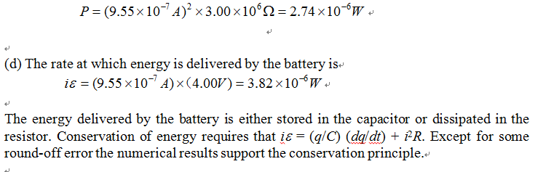
Answer 4

